Slide 1
ChannelFinder: A directory service

Slide 2
Motivation and Objectives
A flat name space restricts seriously:
Clients need to know all channel names beforehand
Portable generic clients must be simple
Apps need full configuration or framework supplied service
Develop a Directory Service
Generic
No dependency on installation and local conventions
Simple and fast (enough)
Use standards wherever possible
Provides "query-by-functionality"

Slide 3
Publish/subscribe
Command/response
v3
v4
IOC
IOC
…
IOC
IOC
…
v4
CA client (JCA/CAJ)
pvA client
Masar
…
Core Client Technologies
Data Sources
CA
Sim
Test
pvA
Aggregation
pvManager
AccelUtils
Java/Python
Web based REST services
Data Definition
vTypes
API
ChannelFinder
Visualization
Graphene
API
Olog
CSS Core
ChannelFinder Integration
Olog Integration
…
...
…
BOY
Web UI and other clients
Scripts and utilities
DataBrowser
Logbook
cf-update
CSS
…
…

Slide 4
ChannelFinder Data
Set of Channels (unique names)
Each Channel has an arbitrary number of Properties (name/value pairs) and Tags (names)
Each Channel, Property, or Tag has an Owner (group) to allow basic access control
All names and values are strings

Slide 5
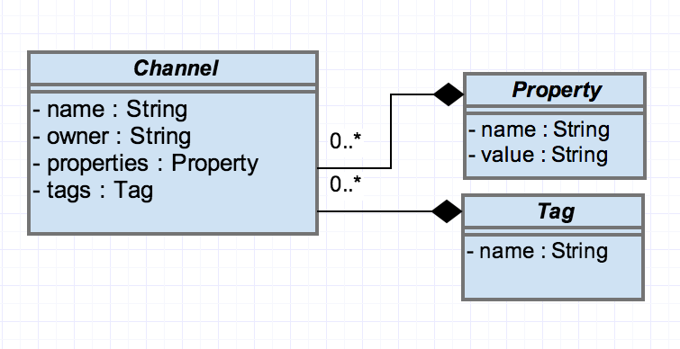
Directory Data

Slide 6
Channel example
"name":"XF:31IDA-OP{Tbl-Ax:X1}Mtr",
"owner":"train",
"properties":
["handle":"Setpoint",
"axis":"1",
"hostname":"training.org.epics",
"iocName":"motorsim",
"time":"2016-03-21"]
"tags":
["motor",
"sys.XF:31"
]

Slide 7
Query Example
XF:31*IDA*
All pvs from the insertion device 31
XF:31*IDA*&axis=4*
All pvs from the insertion device 31 belonging to axis 4
XF:31*IDA*&axis=4*&pvStatus=active
All pvs from the insertion device 31 belonging to axis 4
and with pvStatus active
XF:31*IDA*&axis=4*&tag=aphla.sys.SR
All pvs from the insertion device 31 belonging to axis 4
with tag sys.XF:31

Slide 8
Example Data set

Slide 9
device FM1G4C02A
Channel Name | SR:C02-MG:G04A{HFCor:FM1} |  | SR:C02-MG:G04A{VFCor:FM1}
 | Fld-I | Fld-SP | Fld-I | Fld-SP
handle | READBACK | SETPOINT | READBACK | SETPOINT
elemName | FXM1G4C02A |  | FYM1G4C02A
elemType | HFCOR |  | VFCOR
elemField | x |  | y
devName | FM1G4C02A
sEnd | 65.5222
cell | C02
girder | G4
symmetry | A
length | 0.044
ordinal | 263 |  | 264
tags | eget | eput | eget | eput
 | x |  | y
 | sys.SR

Slide 10
device FM1G4C02A
Channel Name | SR:C02-MG:G04A{HFCor:FM1} |  | SR:C02-MG:G04A{VFCor:FM1}
 | Fld-I | Fld-SP | Fld-I | Fld-SP
hostName | ps-psioc-c02.cs.nsls2.local
iocName | ps-C02A
updateTime | 2015-03-13
active | True
Tags | archive

Slide 11
ChannelFinder in CSS
Quick demo of the ChannelFinder applications

Slide 12
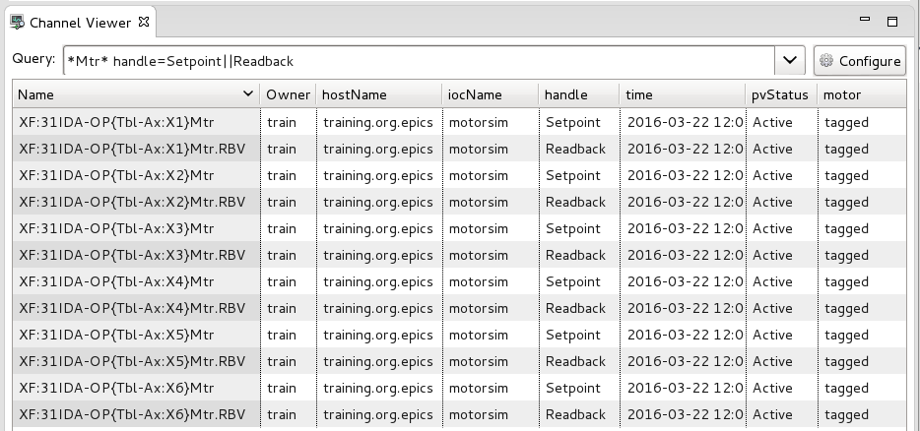
ChannelViewer
CS-Studio → Display → ChannelViewer

Slide 13
ChannelViewer
Query can be construted for the Name, Property value, Tags associated with channels
Wildcard character like "*", "?" can be used in the queries
prop=val1||val2 is equivalent to prop=val1 OR prop=val2
prop=val1 tag=myTag is equivalent to prop=val1 AND tag=myTag

Slide 14
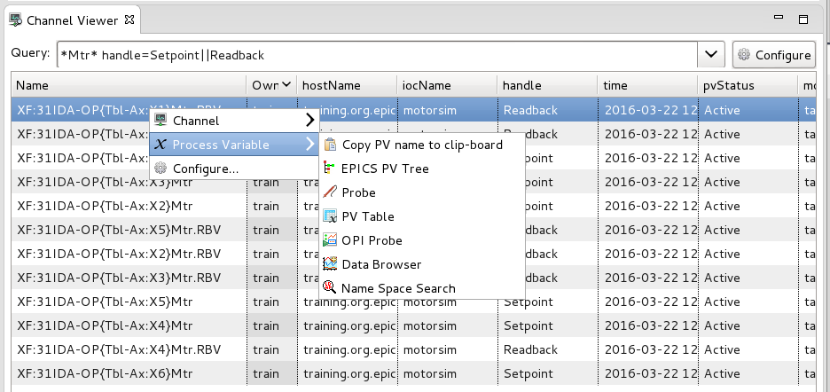
ChannelViewer
Channel/s can be forwarded to other cs-studio applications

Slide 15
ChannelViewer
Channel/s can be forwarded to other cs-studio applications

Slide 16
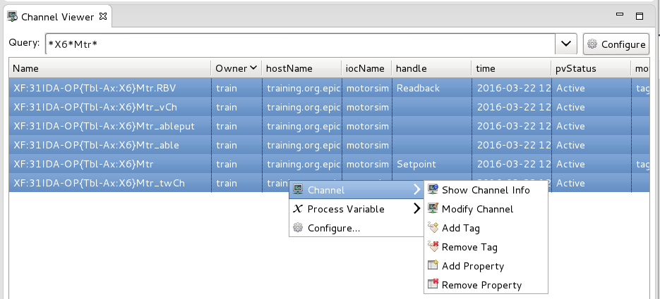
ChannelViewer - editing
Add a tag/property to a channel or a group of channels
Remove a tag/property from a channel or a group of channels

Slide 17
ChannelViewer - editing
Query *X6*Mtr to select all the channels for associated with motor6
Select all pv’s and choose "add property"

Slide 18
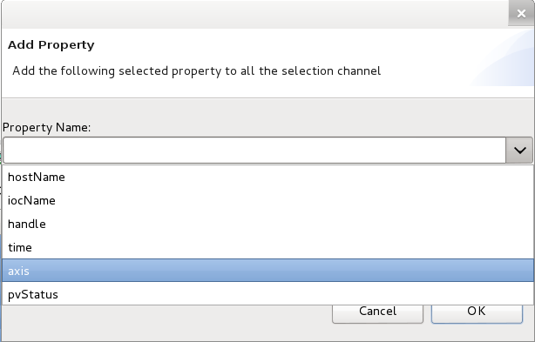
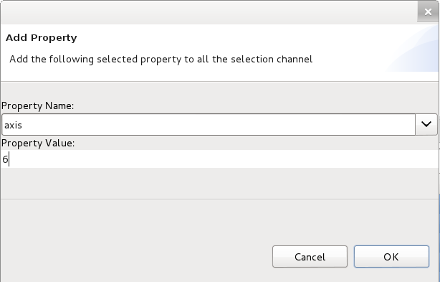
ChannelViewer - editing
Select the property "Axis" from the listed properties.
Enter a value for the property e.g. “X6"

Slide 19
Channel Tree
Channel Tree by Property allows to create an hierarchical view of the channels by using properties and their values.

Slide 20
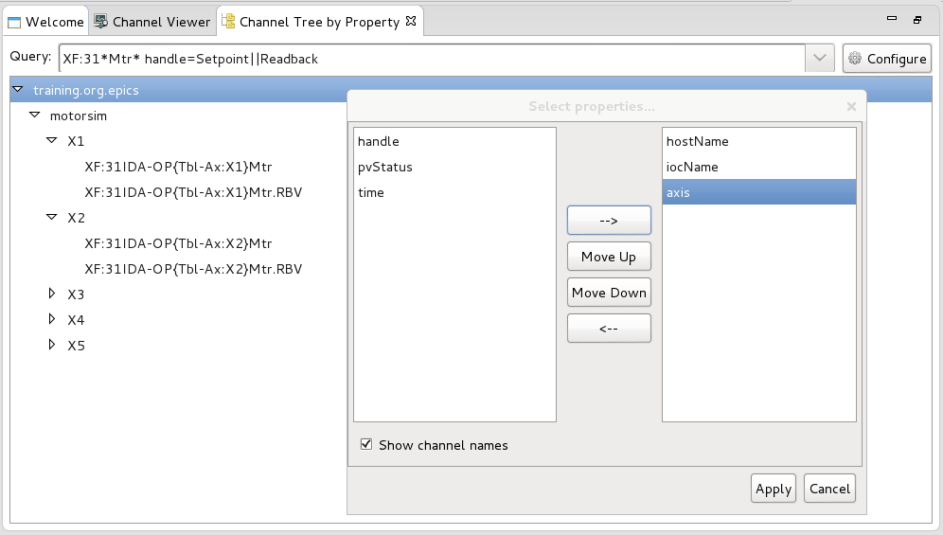
Channel Tree
Query: XF:31*Mtr* handle=Setpoint||Readback
Configure the tree by selecting the properties to be used to create the hierarchy (hostname, handle, axis,…)
Notes:
Exercise: create the tree

Slide 21
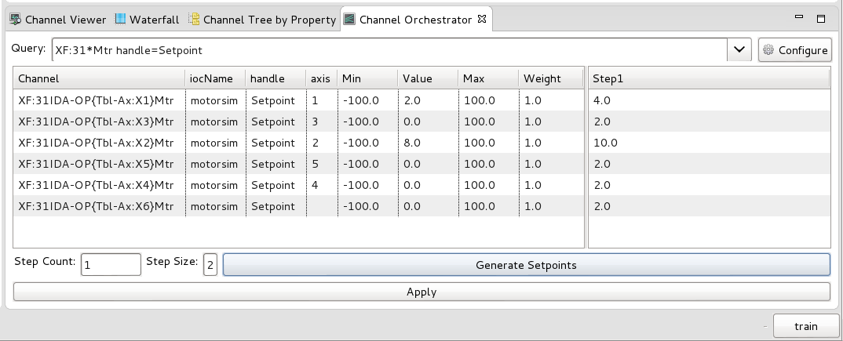
Channel Orchestrator
The channel orchestrator is a tool to assist in preparing and writing a group of set points

Slide 22
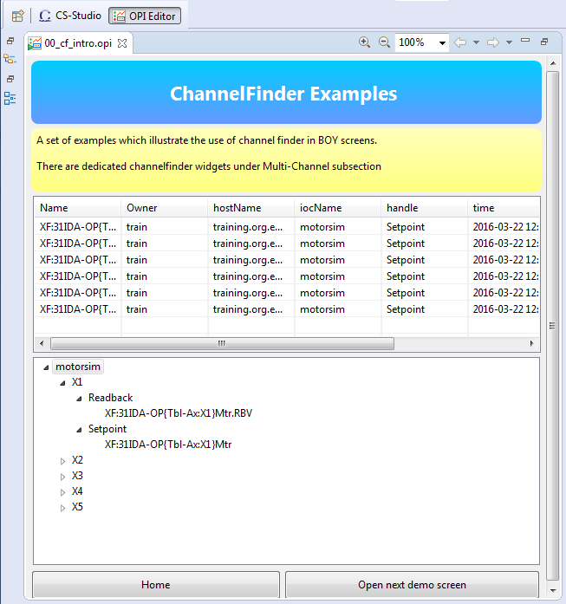
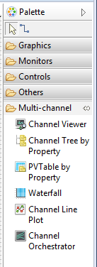
ChannelFinder & BOY
Dedicated ChannelFinder widgets
Notes:
channelviewer

Slide 23
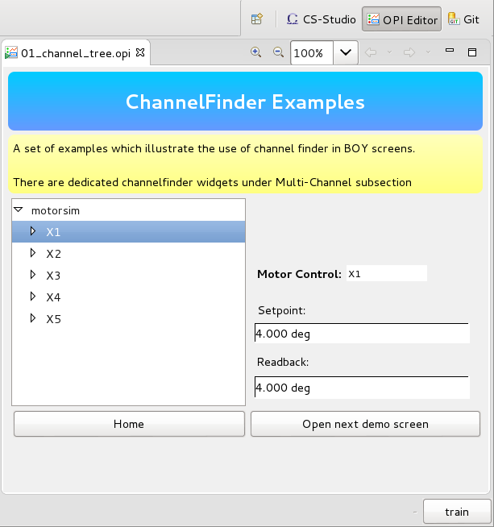
ChannelFinder & BOY
Embed channel tree by property widget into the opi
Set Channel query: “XF:31*Mtr*”
Tree Properties: iocName, axis, handle
Selection Expression: #(axis)
Selections from this widget can be used to initialize other widgets

Slide 24
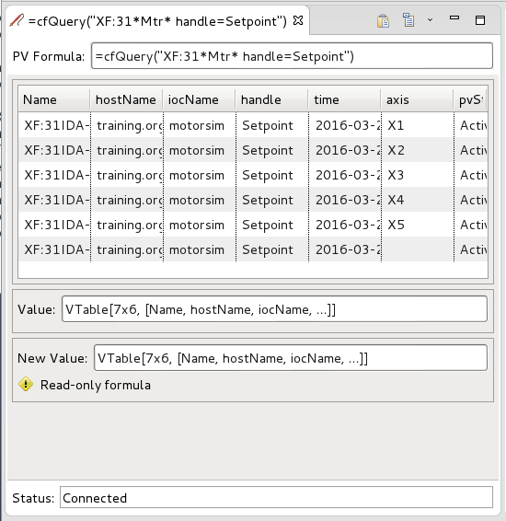
cfQuery
Accessing channelfinder data in opi screens
=cfQuery(Vstring query) : VTable

Slide 25
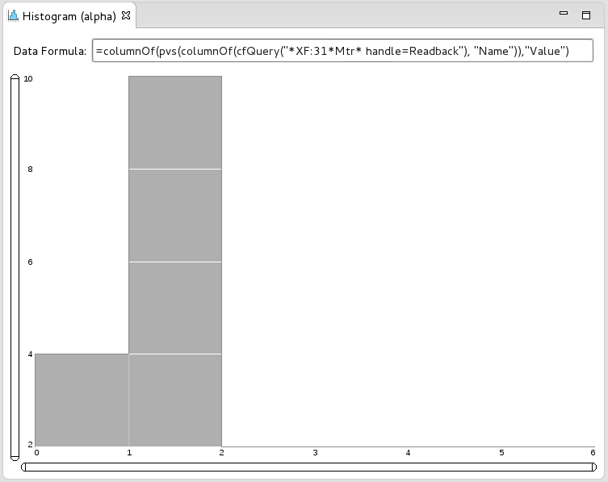
cfQuery
Combining cfQuery with other formulas to create tables/arrays which can be then used with existing cs-studio widgets
=columnOf(pvs(columnOf(cfQuery("*XF:31*Mtr* handle=Readback"), "Name")),"Value")

Slide 26
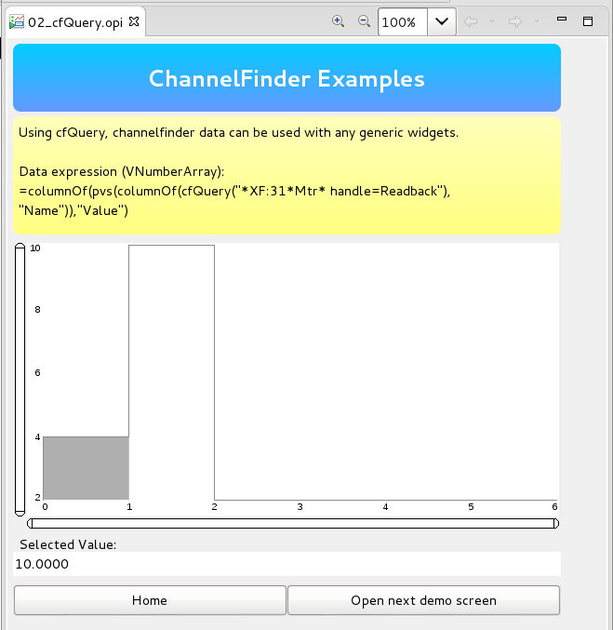
ChannelFinder & BOY
Notes:
Orchestrator and histogram

Slide 27
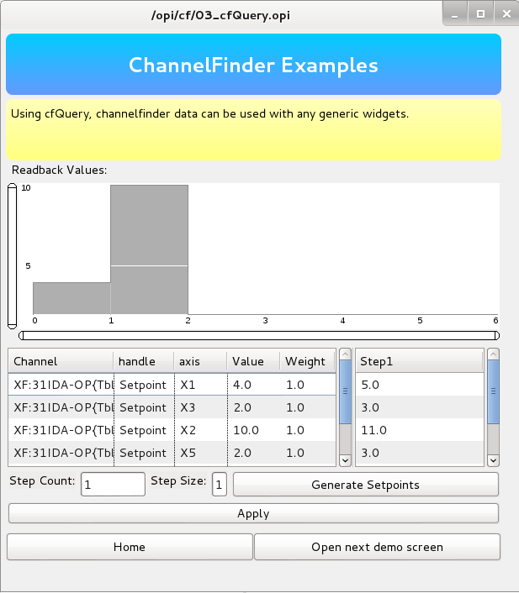
ChannelFinder & BOY
Notes:
Orchestrator and histogram

Slide 28
Questions

